Slide 1
Lariat Rental Car Analysis Presented by: Hanna Humphrey
Goals:
Provide recommendations and a call to action for reducing cost and increasing revenue

Slide 2
Lariat Rental Car Analysis
Background
4,000 cars
$162.26 average daily rental rate per vehicle
50 branches total
28 no airports
22 airports
$52,830,207 gross revenue
325,608 rented days
$19,908,150 net revenue

Slide 3
Recommendations
Strategy 1: Increase daily rental rate by 10% at airport locations
Strategy 2: Increase daily rental rate by 10% at all locations

Slide 4
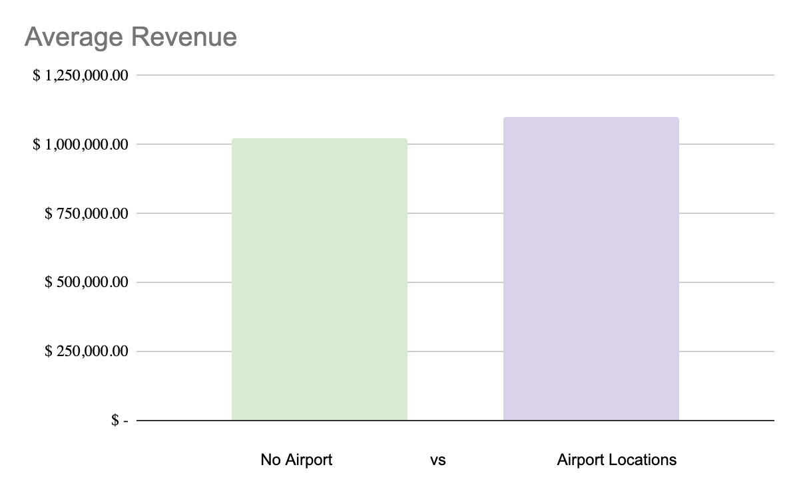
Strategy 1: Increase daily rental rate by 10% at airport locations
 | Average Revenue
Locations without Airports: | $1,020,866.71
Locations with Airport: | $1,102,088.14

Slide 5
Strategy 1: Increase daily rental rate by 10% at airport locations
 | Strategy 1
Total Cars | 4,000
Branches with increase | 22
Total Rented Days of increased pay structure | 130,243
Avg Price Per Day | $178.50
Gross Revenue | $55,305,300.00
Total Costs | $32,922,057.00
Profit | $22,383,243.00
Profit Margin | 40%
Change in Profit | $2,475,093.00

Slide 6
Strategy 2: Increase daily rental rate by 10% at all locations
 | Strategy 2
Total Cars | 4,000
Branches with increase | 50
Total Rented Days of increased pay structure | 325,608
Avg Price Per Day | $178.50
Gross Revenue | $58,121,028.00
Total Costs | $32,922,057.00
Profit | $25,198,971.00
Profit Margin | 43%
Change in Profit | $5,290,821.00

Slide 7
 | Benchmark | Strategy 1 | Strategy 2
Total Cars | 4,000 | 4,000 | 4,000
Branches with increase | - | 22 | 50
Total Rented Days of increased pay structure | - | 130,243 | 325,608
Avg Price Per Day | $162.26 | $178.50 | $178.50
Gross Revenue | $52,830,207.00 | $55,305,300.00 | $58,121,028.00
Total Costs | $32,922,057.00 | $32,922,057.00 | $32,922,057.00
Profit | $19,908,150.00 | $22,383,243.00 | $25,198,971.00
Profit Margin | 38% | 40% | 43%
Change in Profit | - | $2,475,093.00 | $5,290,821.00
Comparisons

Slide 8
Call to Action
First, implement Strategy 1 and monitor results
Then, implement Strategy 2

Slide 9
Questions?

